Slide 1
VOTING WEB APPLICATION USING
DJANGO FRAMEWORK
DJANGO

Slide 2
VOTING APPLICATION
The Voting Web Application aims to provide a robust and user-friendly platform for conducting various voting activities. By leveraging the power of Django and modern web technologies, the application will offer a seamless voting experience while ensuring security, scalability, and performance.

Slide 3
PROJECT OVERVIEW
The Voting Web Application is a platform designed to facilitate various types of voting activities, from polls to elections. It allows users to create, participate in, and manage voting campaigns in an efficient and user-friendly manner. The application will be built using Django, a high-level Python web framework, known for its simplicity and scalability.

Slide 4
USING TECHNOLOGY
Backend: Django, Python
Frontend: HTML, CSS, JavaScript
Database: SQL

Slide 5
FUTURE ENHANCEMENTS
Advanced Analytics
Social Media Integration
Security Enhancements
Localization

Slide 6
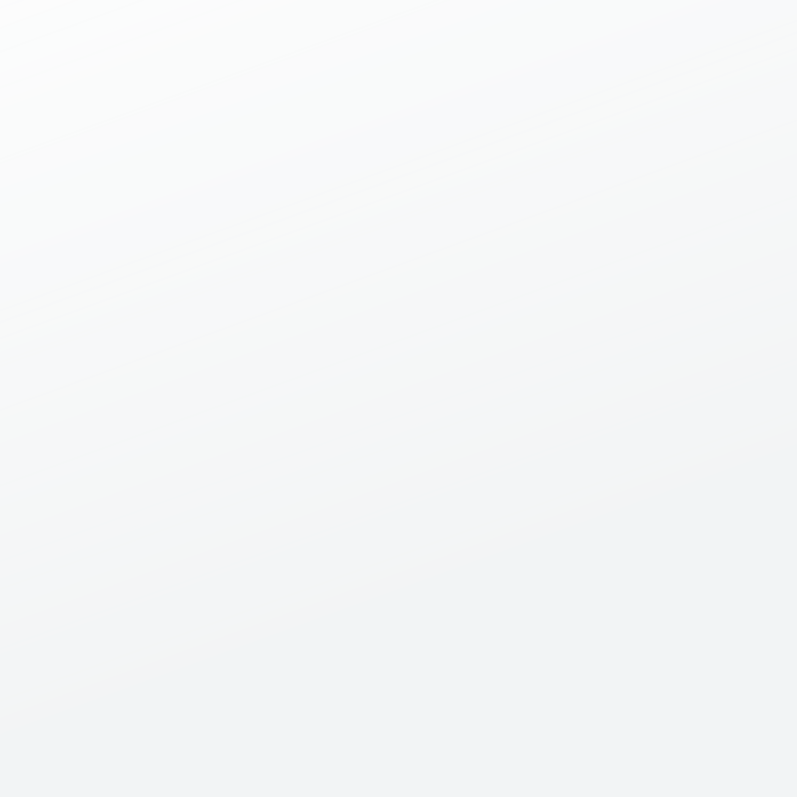
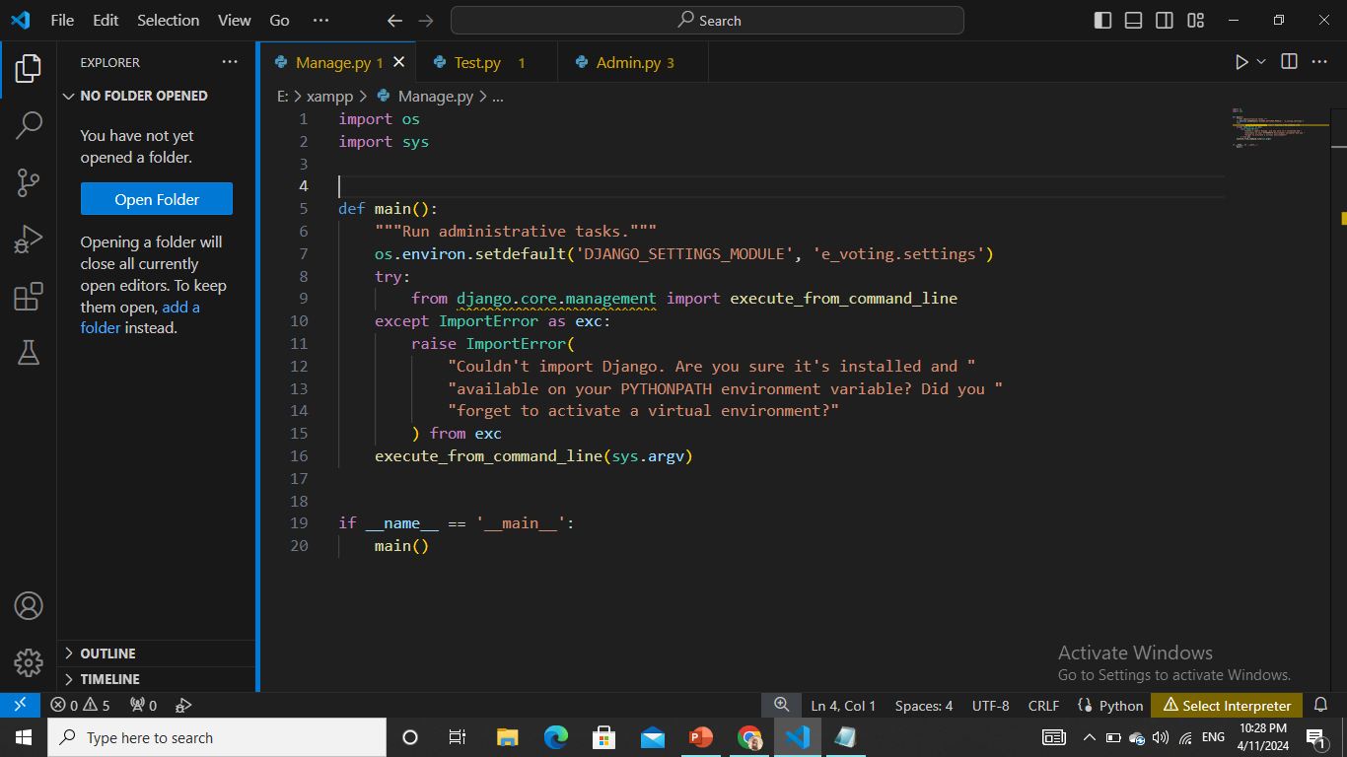
WWW.REALLYGREATSITE.COM

Slide 7
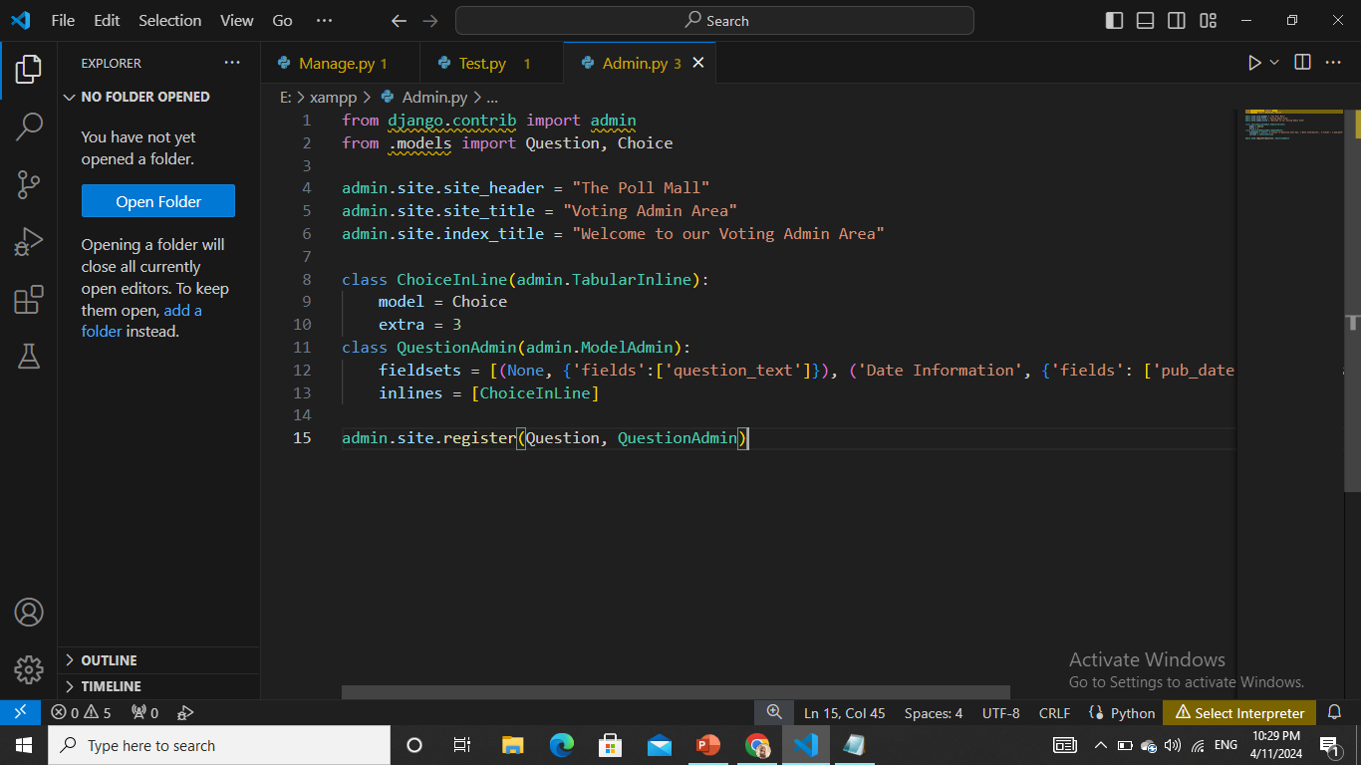

Slide 8
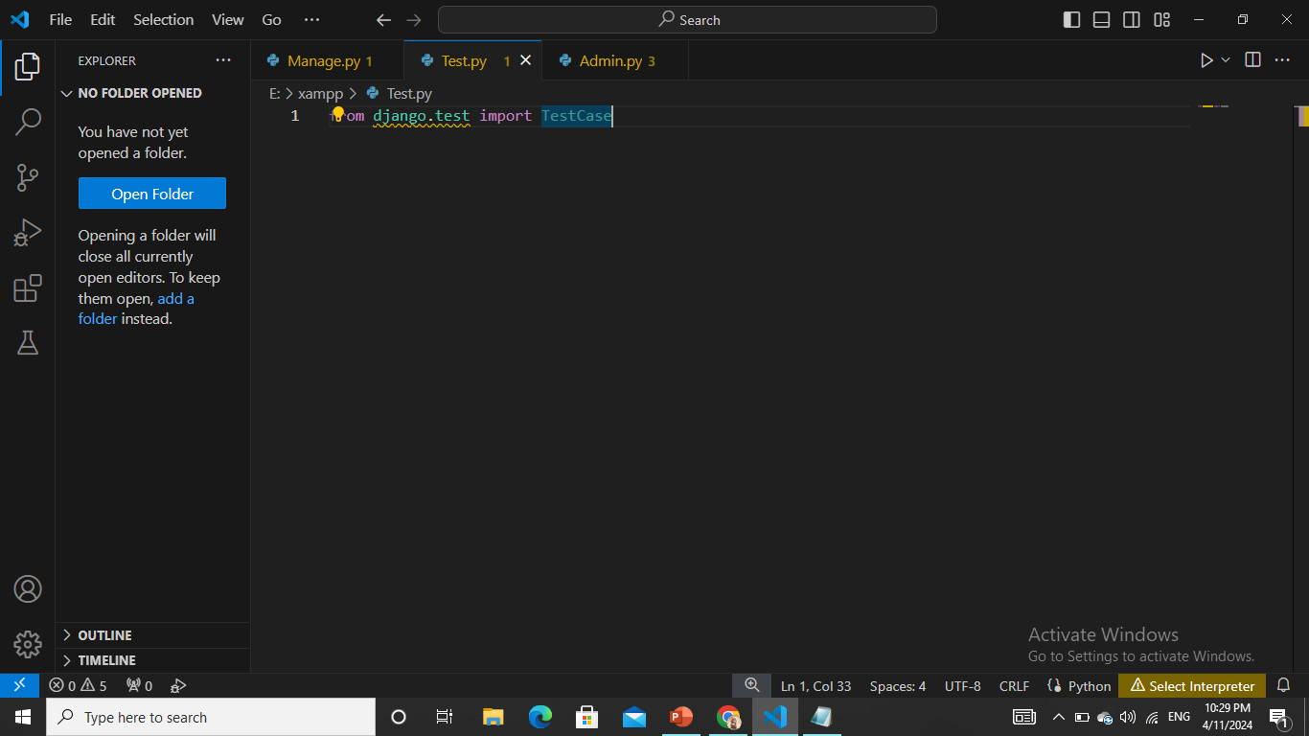
BUSINESS
PROJECT
WWW.REALLYGREATSITE.COM

Slide 9
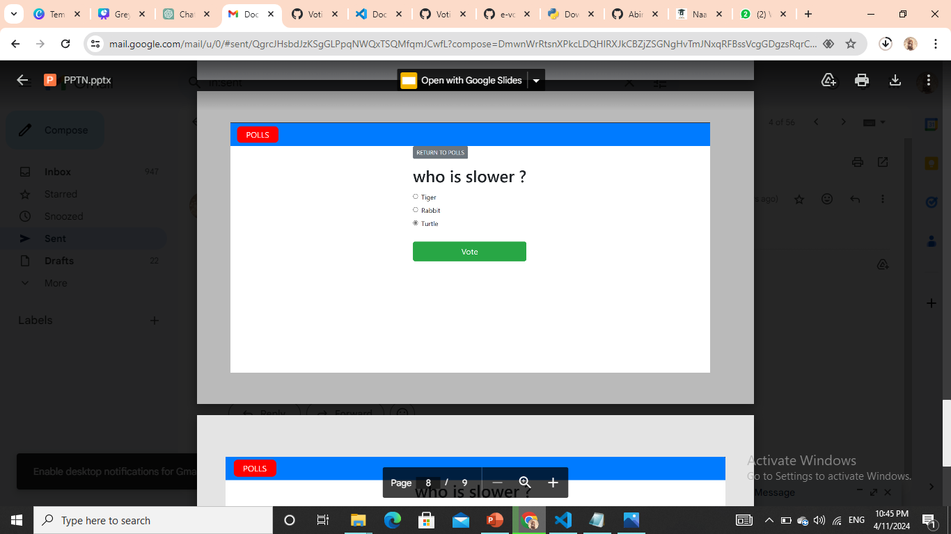
OUTPUT

Slide 10
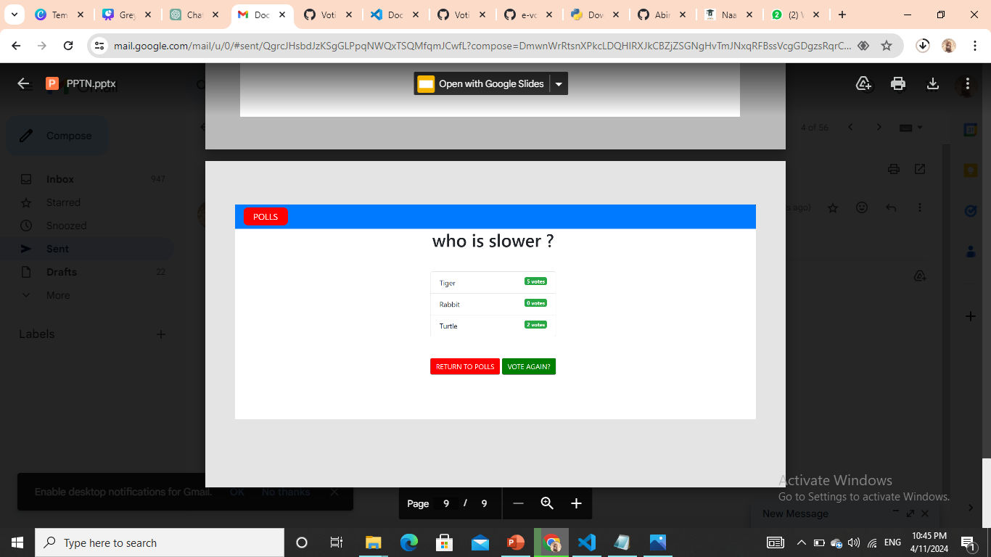

Slide 11
THANK YOU

